Slide 1
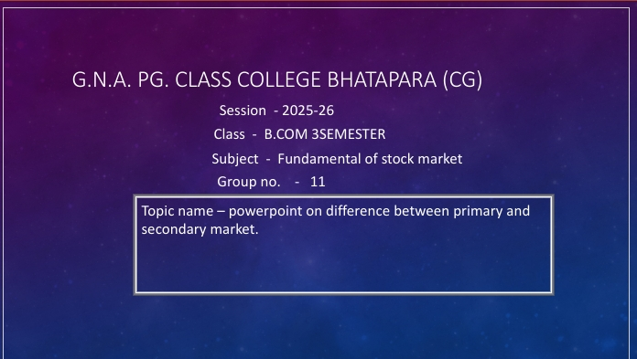

Slide 2


Slide 3

Market Types
Understanding Primary and Secondary Markets

Slide 4
Introduction
The financial market consists of two main segments: the primary market and the secondary market. These markets play distinct but interconnected roles in capital formation and asset trading. This presentation explores their definitions, functions, and significance in investment and economic growth.

Slide 5

Primary
Market

Slide 6
Definition and Purpose
The primary market is where new securities are issued for the first time to raise capital directly from investors. It enables companies and governments to obtain funding for expansion, projects, or operations by selling stocks or bonds. This market supports capital formation by providing fresh financial resources.

Slide 7
Types of Securities Issued
Securities issued in the primary market include initial public offerings (IPOs), bond issuances, and private placements. These instruments represent new equity or debt and form the basis for future trading in the secondary market. They cater to various investor categories depending on risk and return preferences.

Slide 8

Role of
Underwriters
Underwriters act as intermediaries in the primary market, facilitating the issuance process. They evaluate the issuer’s value, set prices, and often guarantee the sale of securities by purchasing them before distributing to investors. Their role is crucial in managing risk and ensuring market confidence.

Slide 9

Secondary
Market

Slide 10
Definition and Function
The secondary market is where previously issued securities are bought and sold among investors. It provides liquidity and continuous price discovery, allowing holders of securities to convert assets into cash easily. This market supports efficient allocation and valuation of financial instruments.

Slide 11
Types of Exchanges
Secondary market transactions take place on organized stock exchanges like the NYSE or Nasdaq, as well as on over-the-counter (OTC) platforms. Exchanges impose rules and transparency, while OTC trading may offer more flexibility, catering to different trading needs and security types.

Slide 12

Price Determination
Mechanisms
In the secondary market, prices are determined by supply and demand dynamics. Factors such as investor sentiment, company performance, economic indicators, and market conditions influence pricing. This continuous price discovery ensures securities are fairly valued, providing transparency and efficiency to traders and investors.

Slide 13

Key
Differences

Slide 14

Issuance vs.
Trading
The primary market focuses on the issuance of new securities, allowing entities to raise capital. Conversely, the secondary market is dedicated to the trading of existing securities, providing liquidity and enabling investors to buy or sell shares after the initial offering.

Slide 15

Market
Significance

Slide 16
Importance for Investors
Markets offer investors a platform to access securities, diversify portfolios, and manage risks. The primary market provides opportunities to invest early in companies, while the secondary market allows for flexibility and quick realization of investment value through trading.

Slide 17
Influence on Economy
Both markets are essential for economic growth. The primary market fuels business expansion and infrastructure development by channeling funds. The secondary market promotes efficient capital allocation, stability, and investor confidence, ultimately supporting broader financial system health.

Slide 18

Conclusions
Understanding the differences between primary and secondary markets clarifies their unique roles in financial ecosystems. The primary market facilitates capital raising, while the secondary market provides liquidity and valuation. Together, they support investor opportunities, economic growth, and market integrity, making both vital to modern finance.

Slide 19
Thank you

